Slide 1
How to build and refine a priori models to predict behavioral performance in interference tasks
Psicostat – 21 Giugno 2024
Giada Viviani, Ettore Ambrosini

Slide 2
OBJECT
Show the steps (and the reasoning behind them) we followed to build detailed a-priori pre-registered models: quantitative predictions
Evidence in the literature to make general predictions + refine them to make quantitative predictions
Outline:
Brief theoretical background and open question we wanted to address
General underlying idea: Multi-component nature of the Stroop task
Show you that we started from a simple study but then we needed other studies of increasing complexity to refine the model (and still we haven’t finished) → so far 3 pre-registered studies

Slide 3
Semantic priming performance
2
1.8
apple
peach
Define the direction: Effects in literature/previous studies
1.6
???
Performance (iRT: 1000/ms)
1.4
&%£
peach
1.2
Predicted
1

Slide 4
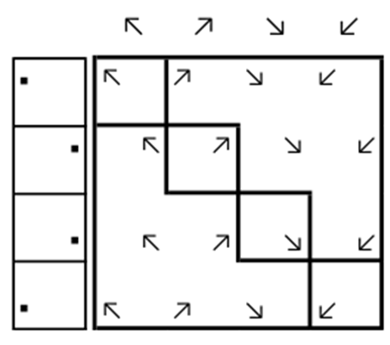


Background


Congruent
Incongruent
–
Stroop Effect (SE)
Performance decline

Slide 5
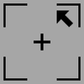
Background
MULTIPLE-LOCI HYPOTHESIS: The Stroop performance is a composite measure
of three effects occuring at three loci (Parris et al., 2022)
Stimulus-Stimulus overlap
Stimulus-Response overlap
STIMULUS LOCUS
RESPONSE LOCUS
TASK LOCUS
Interference
+
Facilitation
Dimensional overlap model (Kornblum, 1999)
Interference
Two competing task-sets

Slide 6
Where we started
The multiple-loci theoretical assumption is fundamental
to design methodologically valid Stroop tasks, but...
nobody has measured empirically (and in a valid way) the effects at these loci!
AIM: To decompose the Stroop effect and empirically assess the weights of the three loci
on facilitation effects (FE) and interference effects (IE)
3 ONLINE STUDIES, PRE-REGISTERED
Study 1: n = 153
Study 2: n = 126
Study 3: preliminary data only (n=26)
(to be continued...)
A-priori power
α = .05; 1-β = .80
d = 0.35 (from available data)
Tests: T₊₀, T₁₀, TOST
required n = 70
Sensitivity power
d > 0.20 (Study 1)
d > 0.22 (Study 2)

Slide 7
Experimental design in a nutshell
Stroop:
Congruency effect (CE)
(aka Stroop effect)
Stimulus
Response
Task
Flanker/Stroop-like:
Congruency effect (CE)
Stimulus
Task
Simon:
Congruency effect (CE)
Response
Task
3 loci CE > 2 loci CE

Slide 8
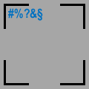
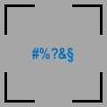
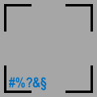



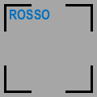
Experimental paradigms (Study 3)
Simon
Stroop-like
Mix
Cong Neutral Incong
Cong Neutral Incong
Cong Neutral Incong
Response (+ Task)
Stimulus (+ Task)
Stimulus + Response (+ Task)
COL (relevant)
POS (irrelevant)
WRD (neutral)
COL (relevant)
POS (neutral)
WRD (irrelevant)
COL (relevant)
POS (irrelevant)
WRD (irrelevant)

Slide 9
Testing the Multiple-loci hyp
Mix_CE (& Stroop_CE) > R_CE & S_CE
2
1.8
1.6
Performance (a.u.)
1.4
1.2
Predicted
1
Cong Neutral Incong
Cong Neutral Incong
CongCong Neutral IncInc
Simon
Stroop-like
Mix

Slide 10
Facilitation and Interference effects
FE
Performance (a.u.)
IE
So we can calculate:
FE = Congruent – Neutral
IE = Neutral – Incongruent
Congruent
Neutral
Incongruent

Slide 11
Mix_FE (& Stroop_FE) > R_FE & S_FE
Mix_IE (& Stroop_IE) > R_IE & S_IE
Predicting facilitation and interference
2
1.8
1.6
Performance (a.u.)
1.4
1.2
Predicted
Is it precise enough? NO!
1
Cong Neutral Incong
Cong Neutral Incong
CongCong Neutral IncInc
Simon
Stroop-like
Mix

Slide 12
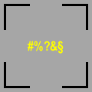
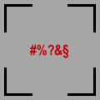
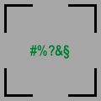
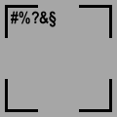
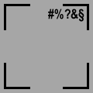
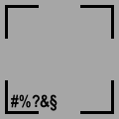
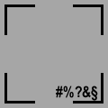

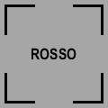
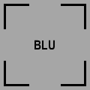
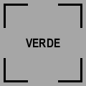
Don’t forget about task Automaticity
Strength of stimulus processing + stimulus-response mapping
COLOR
POSITION
WORD
COL (relevant)
POS (neutral)
WRD (neutral)
From Study 2:
Automaticity (iRT:1/s)
POS > COL > WRD
Single-task paradigms (NO interference)
COL (neutral)
POS (relevant)
WRD (neutral)
2.5 1.7 1.6
(will also be estimated
from participants’
performance in Study 3)
COL (neutral)
POS (neutral)
WRD (relevant)

Slide 13
Mix_FE (& Stroop_FE) > R_FE & S_FE
Mix_IE (& Stroop_IE) > R_IE & S_IE
Arbitrary model
2
1.8
1.6
Performance (a.u.)
1.4
1.2
Predicted
1
Cong Neutral Incong
Cong Neutral Incong
CongCong Neutral IncInc
Simon
Stroop-like
Mix

Slide 14

Find a precise starting point
2
1.8
1.6
Performance (iRT: 1000/ms)
1.4
1.2
Predicted
1
Relevant Task
Cong Neutral Incong
Cong Neutral Incong
CongCong Neutral IncInc
COL
Simon
Stroop-like
Mix

Slide 15
Task interference
COL single task > Neutral trials…
IE_T
But how much?
FE
Performance (iRT: 1000/ms)
IE
Task Asymmetry
Irrelevant/Relevant task Automaticity
→ modulates task interference
COL single task
Congruent
N
Incongruent
1 task only:
No task interference
2 task sets:
Task interference

Slide 16
Predicting neutral trials
2
POS/COL= 1.5
WRD/COL= .9
(neural/cognitive
code sharing)
Simon Asymmetry
+
Stroop-like Asymmetry
1.8
IE_T
IE_T
1.6
IE_T
Performance (iRT: 1000/ms)
1.4
1.2
Predicted
1
Relevant Task
Cong Neutral Incong
Cong Neutral Incong
CongCong Neutral IncInc
COL
Simon
Stroop-like
Mix

Slide 17
Better predicting neutral trials
2
POS/COL= 1.5*10%
WRD/COL=.9*23%
(neural/cognitive
code sharing)
Simon Asymmetry
+
Stroop-like Asymmetry
1.8
IE_T
IE_T
1.6
IE_T
Performance (iRT: 1000/ms)
1.4
1.2
Predicted
1
Relevant Task
Cong Neutral Incong
Cong Neutral Incong
CongCong Neutral IncInc
COL
Simon
Stroop-like
Mix

Slide 18
Better predicting facilitation
1)Number of loci
2)Automaticity of the irrelevant task
2
1.8
FE_R
FE_R
+
FE_S
1.6
Performance (iRT: 1000/ms)
FE_S
1.4
1.2
Predicted
1
Relevant Task
Cong Neutral Incong
Cong Neutral Incong
CongCong Neutral IncInc
COL
Simon
Stroop-like
Mix

Slide 19
Even better predicting facilitation
1)Number of loci
2)Automaticity of the irrelevant task
3)Resp and Stim effects on facilitation
2
1.8
FE_R
FE_R
+
FE_S
1.6
Performance (iRT: 1000/ms)
FE_S
1.4
1.2
Predicted
1
Relevant Task
Cong Neutral Incong
Cong Neutral Incong
CongCong Neutral IncInc
COL
Simon
Stroop-like
Mix

Slide 20
Better predicting interference
1)Number of loci
2)Automaticity of the irrelevant task
2
1.8
1.6
Performance (iRT: 1000/ms)
IE_R
1.4
IE_S
IE_R
+
IE_S
1.2
Predicted
1
Relevant Task
Cong Neutral Incong
Cong Neutral Incong
CongCong Neutral IncInc
COL
Simon
Stroop-like
Mix

Slide 21
Even better predicting interference
1)Number of loci
2)Automaticity of the irrelevant task
3)Resp and Stim effects on interference
2
1.8
1.6
Performance (iRT: 1000/ms)
IE_R
1.4
IE_S
IE_R
+
IE_S
1.2
Predicted
1
Relevant Task
Cong Neutral Incong
Cong Neutral Incong
CongCong Neutral IncInc
COL
Simon
Stroop-like
Mix

Slide 22
Final model
Test 59 a-priori directional hypotheses (t-test + TOST)
Predict the overall pattern of performance (model fit)
Observed
performance
2
1.8
Predicted
performance
1.6
Performance (iRT: 1000/ms)
1.4
1.2
Predicted
Observed
Any other suggestion??
1
Relevant Task
Cong Neutral Incong
Cong Neutral Incong
CongCong Neutral IncInc
COL
Simon
Stroop-like
Mix

Slide 23






STUDY 1
STUDY 2
STUDY 3
Pre-registration
OSF project

Slide 24
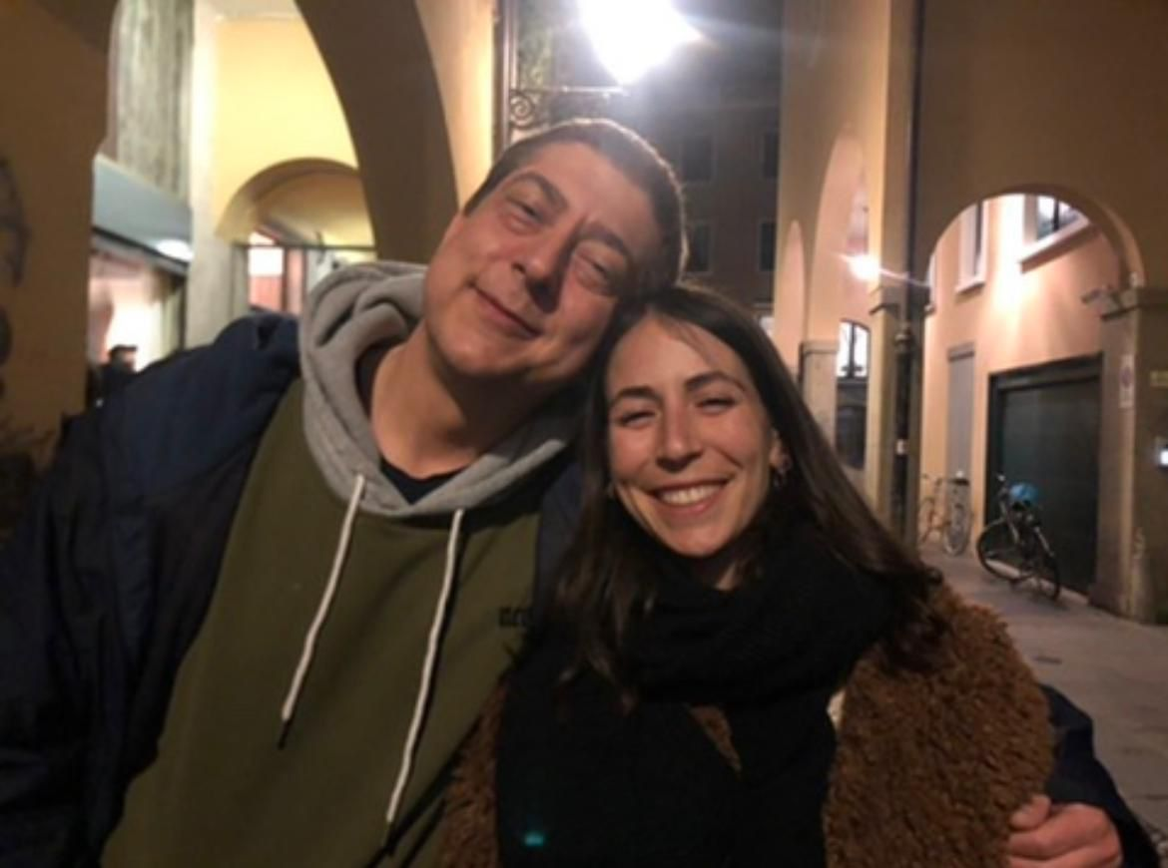

Thank you!
Prof. Ettore Ambrosini

