Slide 1
Reference-based imputation for clustered data
Matthias Gondan
Department of Psychology
University of Innsbruck

Slide 2
Textbook
Baseline
Randomization
Standard
New
End of therapy
End of therapy
Randomized group comparison, asking
“Which therapy works best?”

Slide 3
Reality
Baseline
Randomization
Standard
New
All fine
All fine
Missing
Problems
EOT available
EOT available
Problems
Missing
In psychotherapy trials, it is common to have 30% dropout and missing data.

Slide 4
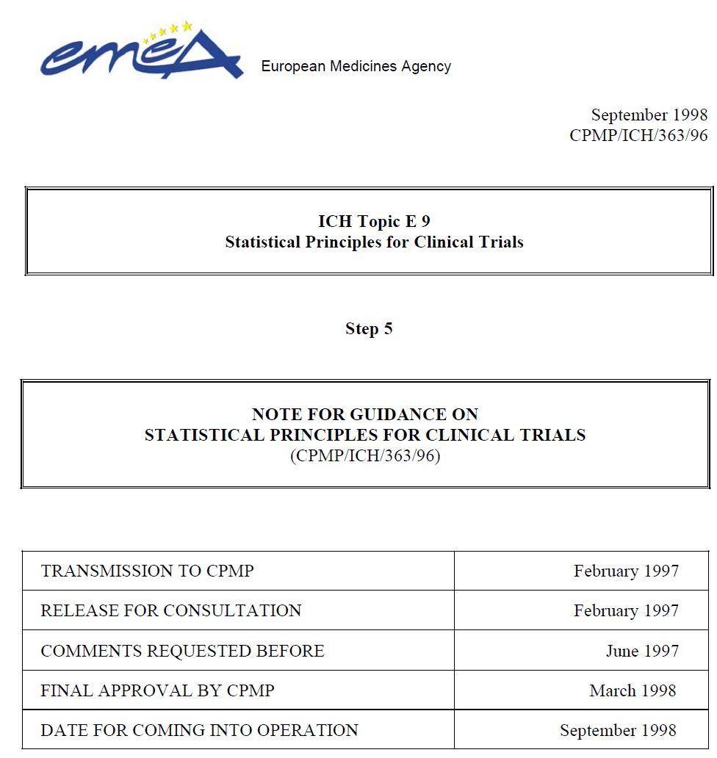
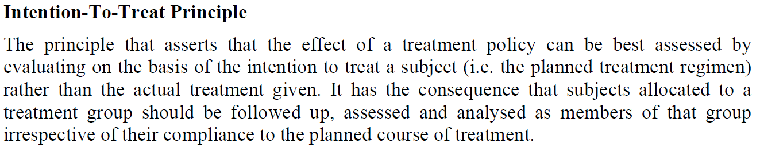
ITT analysis
ICH E9: The primary analysis is based on all included patients, in the way they were randomized.

Slide 5
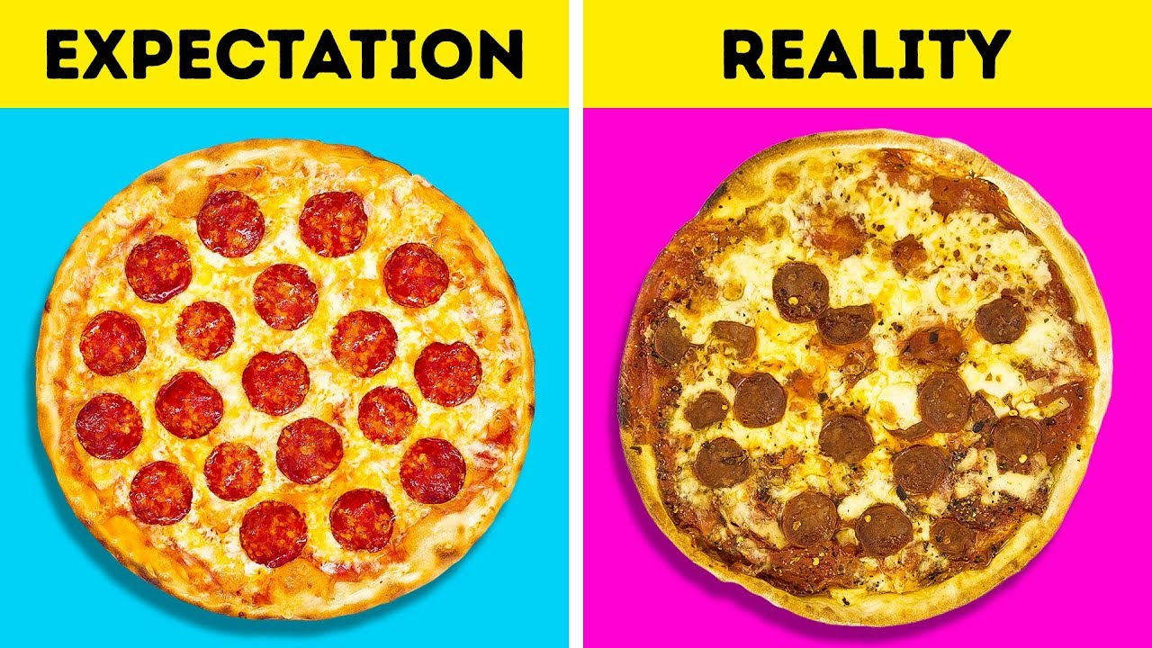
Why ITT?
“…confirmatory clinical trials should estimate the effect of the experimental intervention in the population of patients with greatest external validity and not the effect in the unrealistic scenario where all patients receive treatment with full compliance to the treatment schedule and with a completely follow-up as per protocol.” (quote from the guideline)

Slide 6
The problem of missing data
ID | Age | Group | Received | EOT
1 | 19 | B | B | 34
2 | 24 | A | A | 12
3 | 43 | B | B | 32
4 | 32 | A | A | ___
5 | ___ | A | B | 33
6 | 34 | A | A | 21
7 | 22 | A | X | ___
8 | 37 | B | B | 22
9 | 54 | A | A | 18
10 | 38 | A | A | 22
11 | 61 | B | B | 31
Should not happen
???
We need to impute the missing outcomes somehow.
???

Slide 7
Missing data mechanisms
MCAR
Missing completely at random
Rarely tenable
MAR
Missing at random
Missing data systematically depend on observable information
MNAR
Missing not at random
Missing data systematically depend on unobservable information
Rarely tenable
Missing data do not depend on anything
Typical scenario in clinical trials
We can also have mixtures of the three mechanisms

Slide 8
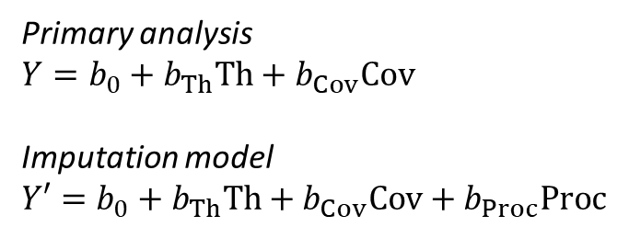
Things that do not work
Regression model for missing data
Therapy
Other Outcomes
Baseline- Covariates
Process variables
Omit the patients with missing data from the analysis
Replace missing data by group average
Regression imputation (with “weak” covariates)
Multiple imputation by regression (with “weak” covariates)
Primary analysis
$Y=b_{0}+b_{Th}Th+b_{Cov}Cov$
Imputation model
$Y′=b_{0}+b_{Th}Th+b_{Cov}Cov+b_{Proc}Proc$

Slide 9
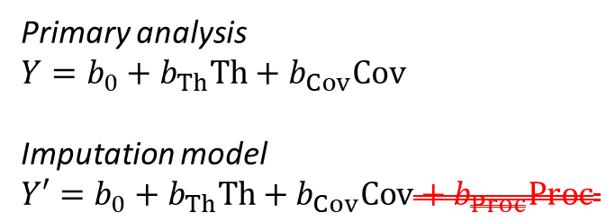
Things that do not work
Regression model for missing data
Therapy
Other Outcomes
Age & Sex
Process variables
Omit the patients with missing data from the analysis
Replace missing data by group average
Regression imputation with “weak” covariates
Multiple imputation by regression with “weak” covariates
Primary analysis
$Y=b_{0}+b_{Th}Th+b_{Cov}Cov$
Imputation model
$Y′=b_{0}+b_{Th}Th+b_{Cov}Cov+b_{Proc}Proc$

Slide 10
Reference-based imputation
The solution

Slide 11
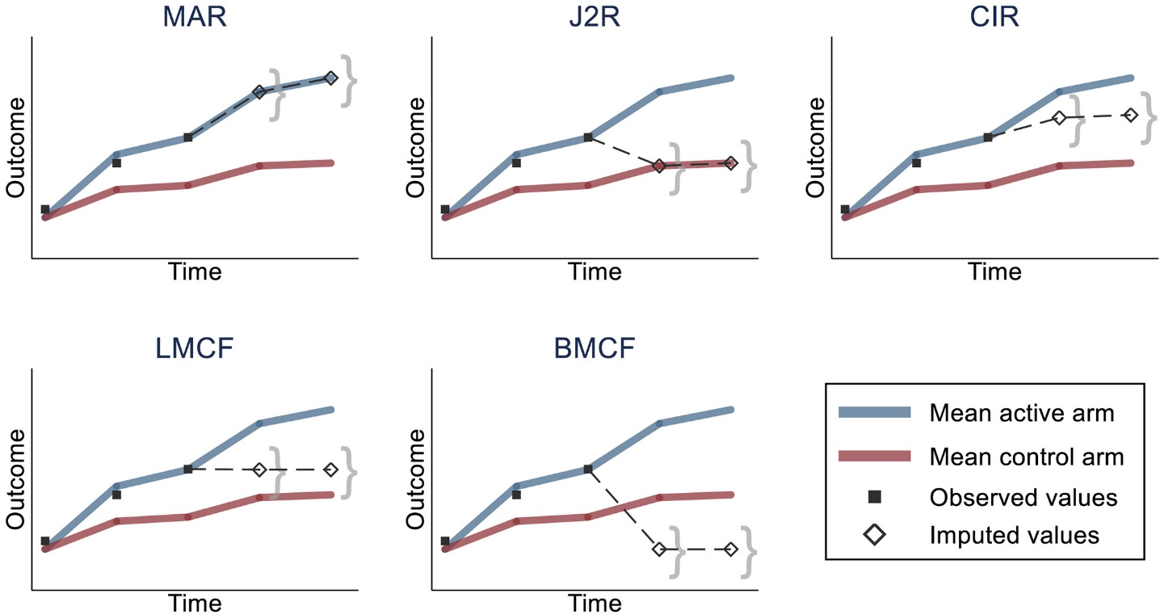
Reference-based imputation
Copy reference (all improvement is lost, CR):
$\tilde{μ}=μ_{ref}$
Jump to reference (after dropout, all improvement is lost, J2R):
$\tilde{μ}=μ_{ref}$, for $t>\tilde{t}$
Copy increments in reference (CIR):
$Δ\tilde{μ}=Δμ_{ref}$, for $t>\tilde{t}$

Slide 12
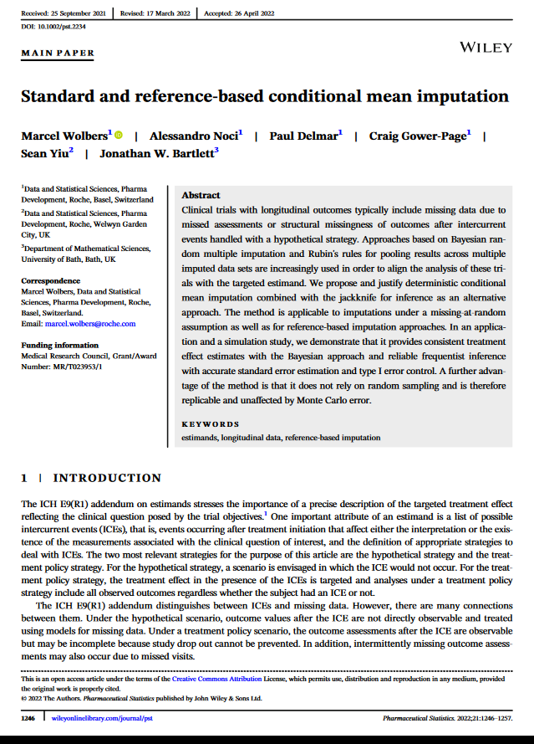
R package rbmi
Meant to streamline the imputation process in RCTs with multiple time points.
easy setup of the imputation model
easy setup of the analysis
Different estimands available (CR, J2R, CIR etc.)
(Rather fast) and deterministic

Slide 13
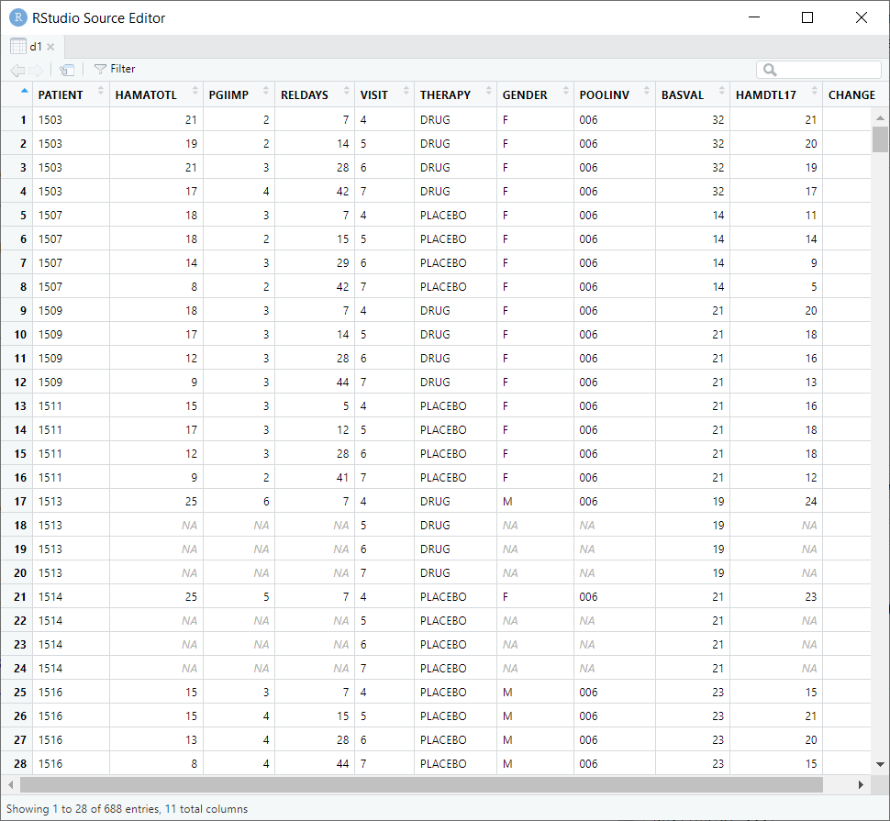
Preparation
Data available in long form, without missing entries
Add NA for missing observations
Keep baseline and therapy
library(rbmi)
data(antidepressant_data)
d = antidepressant_data
d1 = expand_locf(d,
PATIENT=levels(d$PATIENT),
VISIT=levels(d$VISIT),
vars=c("BASVAL",
"THERAPY"),
group=c("PATIENT"),
order=c("PATIENT",
"VISIT"))

Slide 14
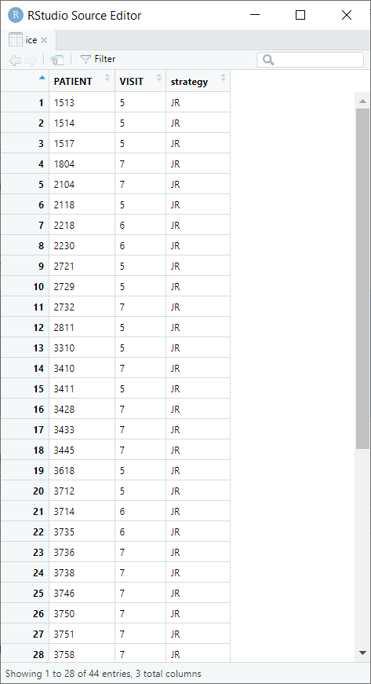
Choose imputation
Code below says how to impute missing data in each patient (here, J2R). If you wish, try out different strategies for different patients (MAR, CR, CIR).
library(dplyr)
ice = d1
%>% arrange(PATIENT, VISIT)
%>% filter(is.na(CHANGE))
%>% group_by(PATIENT)
%>% slice(1)
%>% ungroup()
%>% select(PATIENT, VISIT)
%>% mutate(strategy="JR")

Slide 15
Imputation model
vars = set_vars(outcome="CHANGE",
visit="VISIT",
subjid="PATIENT",
group="THERAPY",
covariates=c("BASVAL*VISIT",
"THERAPY*VISIT"))
method = method_condmean(
type="jackknife")
drawObj = draws(data=d1,
data_ice=ice, vars=vars,
method=method, quiet=TRUE)
imputeObj = impute(drawObj,
references=c(DRUG="PLACEBO",
PLACEBO="PLACEBO"))
Use Therapy, baseline value, visit, as well as interactions for imputation.
jackknife is a non-parametric method to obtain standard errors and confidence intervals
Note that the references are “placebo” for both therapy groups, drug and placebo. That is the point of reference-based imputation.

Slide 16
Analysis
================================================
parameter est se lci uci pval
------------------------------------------------
trt_4 -0.092 0.695 -1.453 1.27 0.895
lsm_ref_4 -1.616 0.588 -2.767 -0.464 0.006
lsm_alt_4 -1.708 0.396 -2.484 -0.931 <.001
trt_5 1.305 0.878 -0.416 3.027 0.137
lsm_ref_5 -4.133 0.688 -5.481 -2.785 <.001
lsm_alt_5 -2.828 0.604 -4.011 -1.645 <.001
trt_6 1.929 0.862 0.239 3.619 0.025
lsm_ref_6 -6.088 0.671 -7.402 -4.773 <.001
lsm_alt_6 -4.159 0.686 -5.503 -2.815 <.001
trt_7 2.126 0.858 0.444 3.807 0.013
lsm_ref_7 -6.965 0.685 -8.307 -5.622 <.001
lsm_alt_7 -4.839 0.762 -6.333 -3.346 <.001
------------------------------------------------
vars = set_vars(
subjid="PATIENT",
outcome="CHANGE",
visit="VISIT",
group="THERAPY",
covariates="BASVAL")
anaObj = analyse(imputeObj,
ancova,
vars=vars)
pool(anaObj,
conf.level=0.95,
alternative="two.sided")

Slide 17
Same with “MAR”
==================================================
parameter est se lci uci pval
--------------------------------------------------
trt_4 -0.092 0.695 -1.453 1.27 0.895
lsm_ref_4 -1.616 0.588 -2.767 -0.464 0.006
lsm_alt_4 -1.708 0.396 -2.484 -0.931 <0.001
trt_5 1.403 0.941 -0.441 3.248 0.136
lsm_ref_5 -4.232 0.734 -5.67 -2.794 <0.001
lsm_alt_5 -2.829 0.603 -4.011 -1.647 <0.001
trt_6 2.225 0.987 0.29 4.159 0.024
lsm_ref_6 -6.381 0.75 -7.852 -4.911 <0.001
lsm_alt_6 -4.157 0.686 -5.502 -2.812 <0.001
trt_7 2.802 1.107 0.633 4.971 0.011
lsm_ref_7 -7.636 0.826 -9.255 -6.017 <0.001
lsm_alt_7 -4.835 0.763 -6.329 -3.34 <0.001
--------------------------------------------------
library(dplyr)
ice = d1
%>% arrange(PATIENT, VISIT)
%>% filter(is.na(CHANGE))
%>% group_by(PATIENT)
%>% slice(1)
%>% ungroup()
%>% select(PATIENT, VISIT)
%>% mutate(strategy="MAR")

Slide 18
Available cases
Call:
lm(formula = CHANGE ~ BASVAL + THERAPY, data = d, subset = (VISIT == "7"))
Coefficients:
(Intercept) BASVAL THERAPYPLACEBO
-2.1873 -0.3273 2.6575
lm(CHANGE ~
BASVAL + THERAPY, data=d,
subset=(VISIT == "7"))

Slide 19
Clustered data
My problem

Slide 20
Independent data
New treatment
Control
Patient 1
Patient 3
Independent data
Patient 2
Patient 4
Patient 8
Patient 5
Patient 6
Patient 7
Patient 9
Patient 10
Patient 12
Patient 13
Patient 11
Patient 14
Each patient is individually randomized.

Slide 21
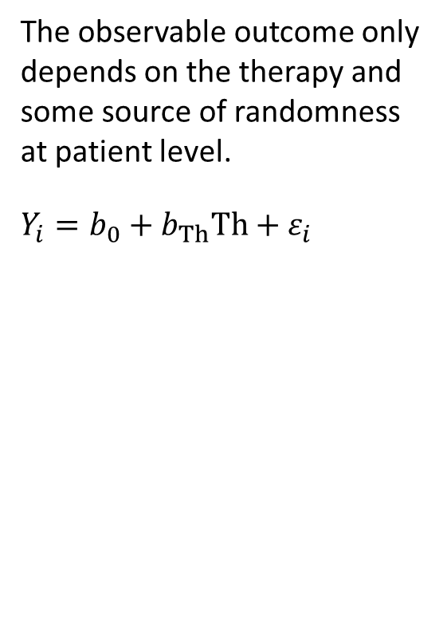
Independent residuals
The observable outcome only depends on the therapy and some source of randomness at patient level.
$$Y_{i}=b_{0}+b_{Th}Th+ε_{i}$$

Slide 22
Cluster-randomized Study
New treatment
Control
Therapist A
Therapist B
Clustered data
Patient 2
Patient 3
Therapist C
Patient 5
Patient 6
Therapist D
Patient 11
Therapist E
Patient 14
Patient 8
Patient 9
Patient 1
Patient 7
Patient 4
Patient 10
Patient 13
Patient 12
Several patients are treated by the same therapist (“cluster”). We may even have group therapy. Randomization is at the level of the therapist.
Treatment outcomes of patients of the same cluster are not independent anymore.

Slide 23
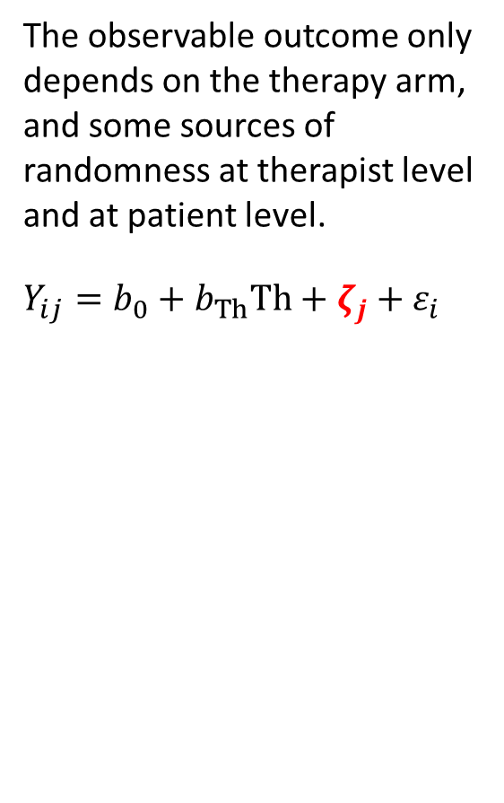
Clustering
The observable outcome only depends on the therapy arm, and some sources of randomness at therapist level and at patient level.
$$Y_{ij}=b_{0}+b_{Th}Th+ζ_{j}+ε_{i}$$

Slide 24
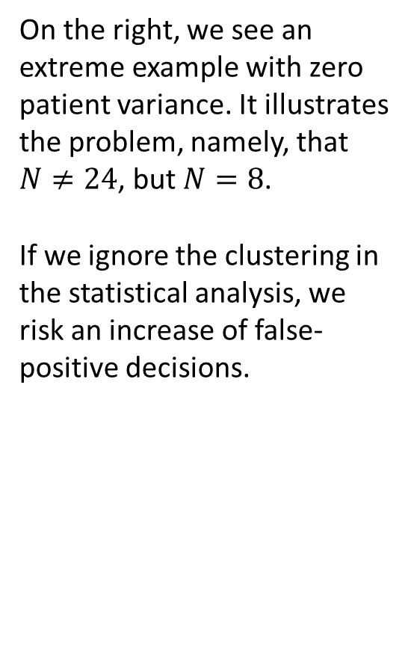
Clustering
On the right, we see an extreme example with zero patient variance. It illustrates the problem, namely, that $N≠24$, but $N=8$.
If we ignore the clustering in the statistical analysis, we risk an increase of false-positive decisions.

Slide 25
Rbmi with clustered data
First steps

Slide 26
Jump to reference, but keep your cluster
New treatment
Control
Therapist A
Therapist B
Clustered data
Patient 2
Patient 3
Therapist C
Patient 5
Patient 6
Therapist D
Patient 11
Therapist E
Patient 14
Patient 8
Patient 9
Patient 1
Patient 7
Patient 4
Patient 10
Patient 13
Patient 12
available
missing
available
missing
available
available
available
available
missing
available
available
missing
available
available
Our first decision was to keep the cluster structure. we basically ignore the clustering in a specific imputation.
Missing outcomes in the active arm are imputed from the control arm, but the patient does not switch to a similar cluster in the control arm.

Slide 27
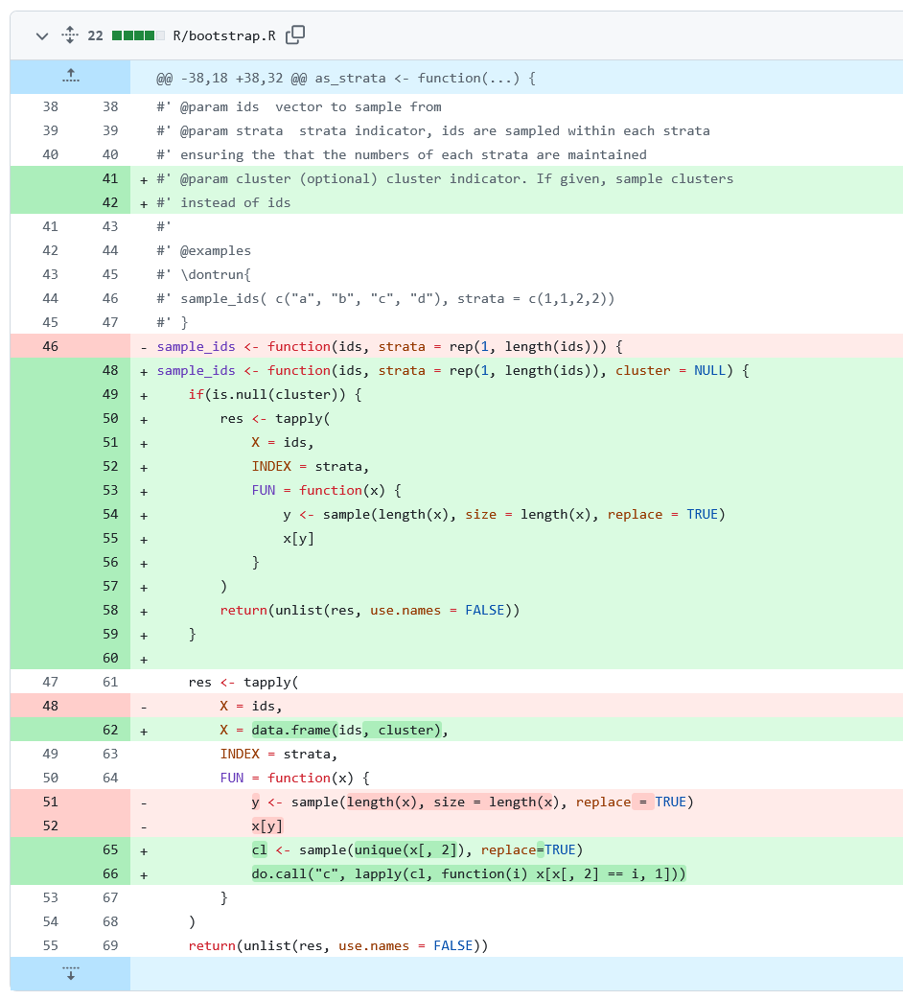
Variance estimation
rbmi uses bootstrap or jackknife to obtain the variance of the estimand after imputation.
To obtain good confidence interval coverage, we replaced these resampling procedures by cluster bootstrap and cluster jackknife.
https://github.com/mgondan/rbmi

Slide 28
Proof of concept
library(rbmi)
library(dplyr)
d <- antidepressant_data
d$PATORIG <- d$PATIENT
d$PATIENT <- as.numeric(as.character(d$PATIENT))
d$CLUSTER <- d$PATIENT
d1 <- d
d1$CLUSTER <- d1$PATIENT
d1$PATIENT <- 10000 + d1$PATIENT
d2 <- d
d2$CLUSTER <- d2$PATIENT
d2$PATIENT <- 20000 + d1$PATIENT
d <- rbind(d1, d2)
d$PATIENT <- as.factor(d$PATIENT)
d$CLUSTER <- as.factor(d$CLUSTER)
d <- expand_locf(d, PATIENT=levels(d$PATIENT),
VISIT=levels(d$VISIT),
vars=c("GENDER", "BASVAL", "THERAPY", "CLUSTER"),
group=c("PATIENT"), order=c("PATIENT", "VISIT"))
# Search for first NA in each patient, request J2R
ice <- d %>%
arrange(PATIENT, VISIT) %>%
filter(is.na(CHANGE)) %>%
group_by(PATIENT) %>%
slice(1) %>%
ungroup() %>%
select(PATIENT, VISIT) %>%
mutate(strategy="JR")
# etc.
Duplicate data, analyze clustered pairs of identical patients, obtain the same result as for individual data.
Quadruplicate data to obtain 2 x 2 clusters with the same data. Ampute either as XX OO or XO XO. This should result in the same estimate, but larger ICCs in XX OO.

Slide 29
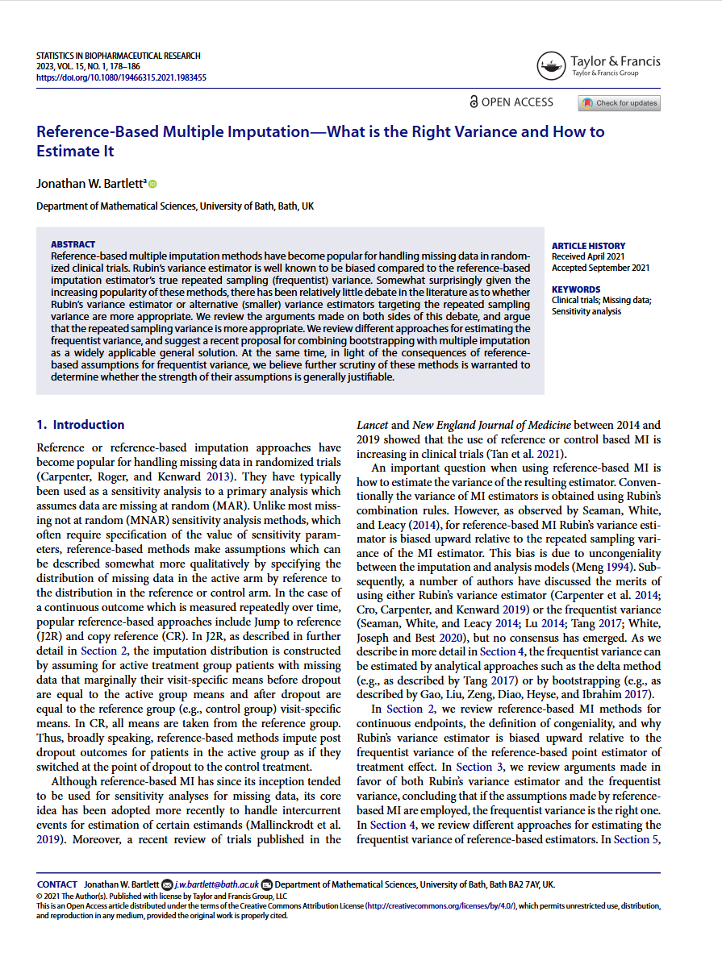
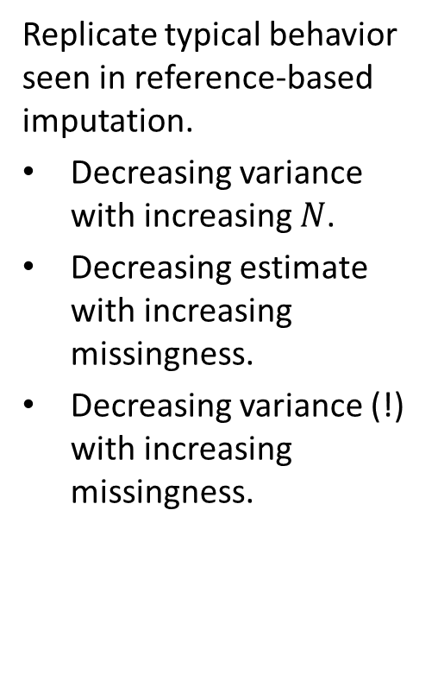
Simulations
Replicate typical behavior seen in reference-based imputation.
Decreasing variance with increasing $N$.
Decreasing estimate with increasing missingness.
Decreasing variance (!) with increasing missingness.

Slide 30
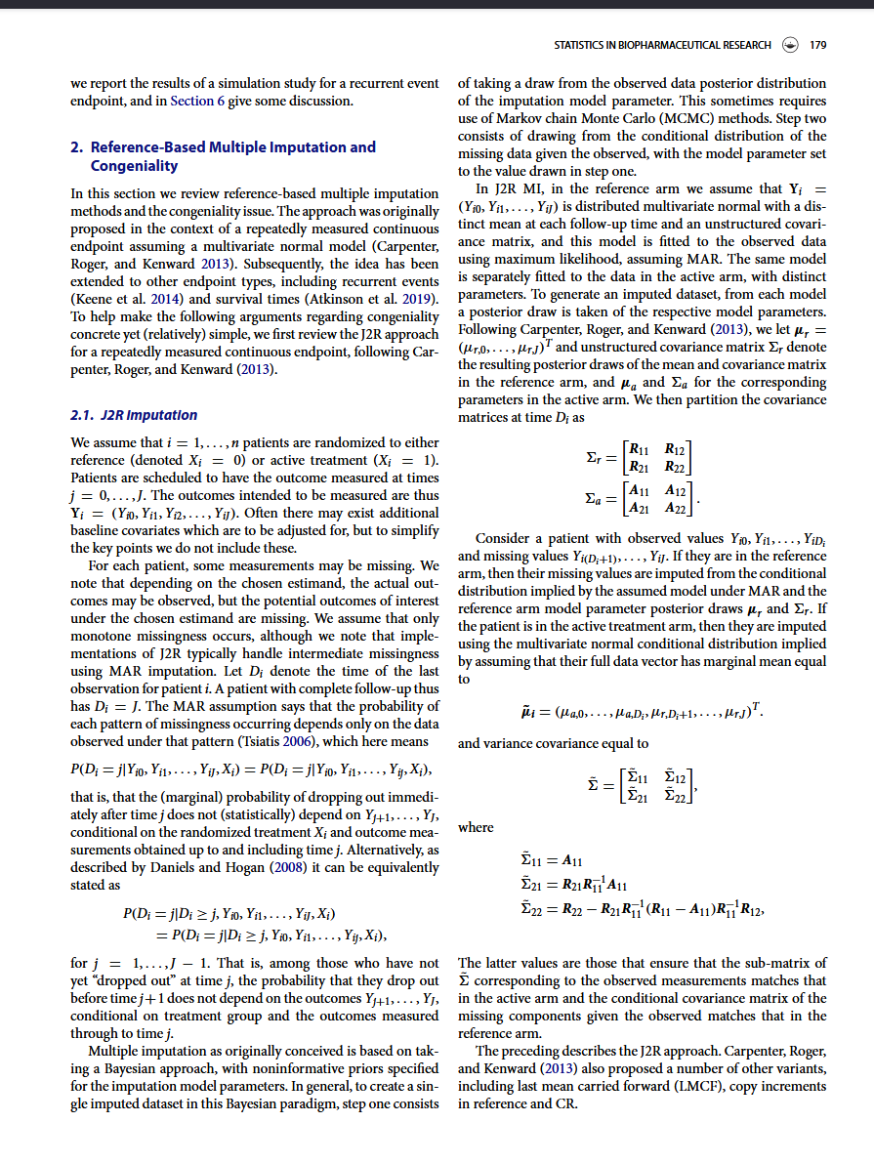
Help needed
Would be great to walk through Bartlett’s article together, and then do a second walk with a “clustered” covariance matrix.

